Slide 1
Florida Association of Institutional Research
2011 Annual Conference
General Education
Institutional Assessment
February 2011

Slide 2
General Education Institutional Assessment
Presenters
Maggie Tymms, Assessment Coordinator for Academic Programs
James Coraggio, Director of Academic Effectiveness and Assessment

Slide 3
SPC Background
SPC, established in 1927, is the oldest
2-year college in Florida
First Community College in Florida to offer 4 year degrees (2002)
9 Campuses throughout the county
2009-10 FTE: 18,707 (LD), 2,055 (UD)
Opening Fall 2010 credited enrollment: 32,429
Annual 2009-10 headcount: 61,592

Slide 4
Presentation
This presentation describes the design, development,
and implementation of SPC’s General Education
Institutional Assessment, which was created in 2009
to improve the processes employed for assessing the
College’s general education outcomes.

Slide 5
Agenda
Background
Purpose of Assessment
Test Development Process
Test Specifications
Pilot Administrations
Response Rates
Statistics and Demographics
Advantages
Next steps

Slide 6
Background
SACS Core Requirement 2.5:
The institution engages in ongoing, integrated, and institution-wide research-based planning and evaluation processes that
  (1) incorporate a systematic review of institutional mission, goals, and outcomes;
  (2) result in continuing improvement in institutional quality; and
  (3) demonstrate the institution is effectively accomplishing its mission.(Institutional Effectiveness)

Slide 7
Background
SACS Comprehensive Standard 3.3.1:
The institution identifies expected outcomes, assesses the extent to which it achieves these outcomes, and provides evidence of improvement based on analysis of the results in each of the following areas: (Institutional Effectiveness)
  3.3.1.1 educational programs, to include student learning outcomes
  3.3.1.2 administrative support services
  3.3.1.3 educational support services

Slide 8
Background
SPC General Education assessments focus
on the general learning outcomes from all
degree programs.
Three-year cycle
Mostly course-based
Direct and indirect measures
Some standardized measures

Slide 9
General Education Outcomes
Critical Thinking
Analyze, synthesize, reflect upon, and apply information to solve problems, and make
decisions logically, ethically, and creatively
Communication
Listen , speak, read, and write effectively
Scientific and Quantitative Reasoning
Understand and apply mathematical and scientific principles and methods
Information and Technology Fluency
Find, evaluate, organize, and use information using a variety of current technologies and other resources
Global Socio-Cultural Responsibility
Participate actively as informed and ethically responsible citizens in social, cultural, global, and environmental matters

Slide 10
Background
Previous model was primarily course-based and may not have reflected the knowledge level of a traditional graduate at time of completion
Discipline specific assessments sometimes consisted of only a few imbedded items and were not consistently administered across classes

Slide 11
Background
Data collection was often difficult and incomplete
Items were developed in isolation and sometimes lacked sufficient review
Hence, results were not always meaningful for purposes of continuous improvement

Slide 12
Purpose of Assessment
To improve the general education assessment process by establishing a model that provides online general education assessments to students near the end of the completion of their degree.

Slide 13
Performance Improvement
From Compliance to Performance Improvement

Slide 14
Test Specifications
Content of each Form
Fifty-item Multiple-Choice test
Six items address Critical Thinking
Eleven Items in each area below address
  Communications
  Scientific and Quantitative Reasoning
  Information and Technology Fluency
  Global Socio-Cultural Responsibility

Slide 15
Test Specifications
Process followed for each of the five outcomes
Operationalize the Goal (List Domains)
Determine the Number of Items (Domains)
Determine Number of Items and Types of Items for each Domain
Identify Competencies for each Domain
Determine Number of Items and Types of Items for each Competency
Using item writing sheets, ‘code’ existing items or create new items to align with Goals, Domains, and Competencies listed in the Test Specification Sheet

Slide 16
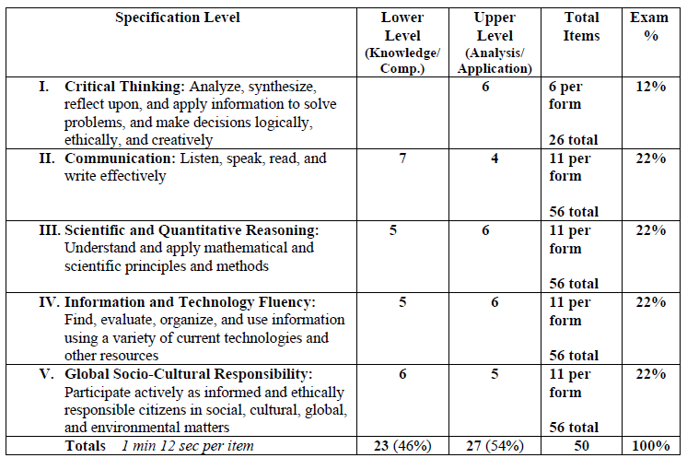
Test Specifications

Slide 17
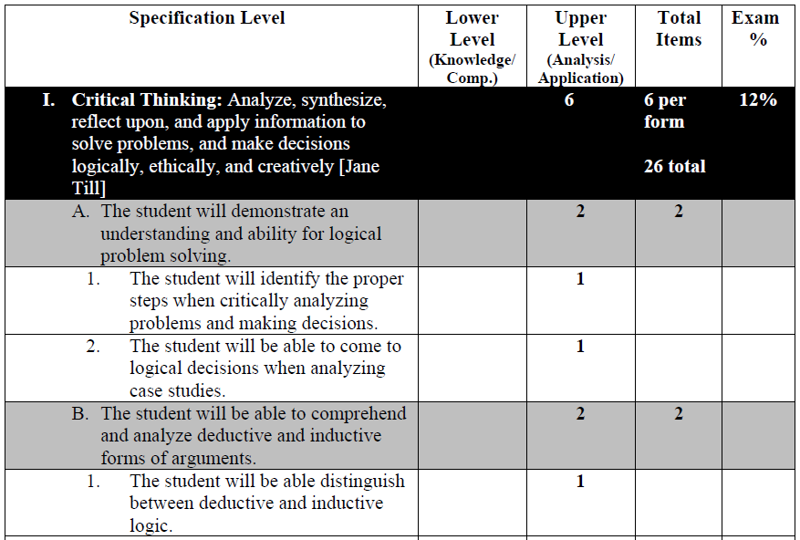
Test Specifications

Slide 18
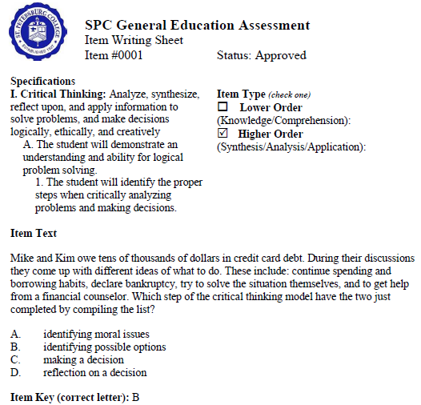
Item Writing Sheet

Slide 19
Pilot Administration
Student Identification Process
  Enrolled at least once in last three semesters
  Completed 45-55 credit hours of course work
  Have not previously taken the assessment
  Identified students are uploaded into SPC learning management system (ANGEL)
  Senior VP invites selected students to participate via email merge
  Gen Ed Test appears as a course in ANGEL

Slide 20
Invitation Letter
Congratulations! You have successfully completed 45 or more credit hours including St. Petersburg College and transfer credits, and have
been selected to participate in the General Education Assessment.
The purpose of this General Education Assessment is to evaluate the quality of our general education curriculum and identify areas for
performance improvement. Your results and those of fellow classmates will assist us in improving the general education courses and
ensuring that we will meet the needs of current and future students.
To complete the assessment, go to your course list in ANGEL. A new course link has been added to your list of courses. It is entitled 420
General Education Outcomes Assessment. Within that course link is a single assessment entitled, General Education Outcomes
Assessment. Please complete this assessment before April 4th.
Upon accessing the assessment, you may receive a ‘Security Warning’ message asking if you want to view only the webpage content that
was delivered securely. Please note that the correct response to the Security Warning message is to select ‘NO’.
You may use a calculator, and we suggest that you have scratch paper available when taking the assessment. On average the assessment
takes about forty minutes to complete. You will be given a ninety-minute time limit to complete the assessment. The ninety minute time limit
starts when you select ‘Begin Assessment’, so it must be completed in one sitting.
If you have any questions regarding this assessment, please contact the department of Academic Effectiveness and Assessment at
727.712.5237, or Ortiz.mary@spcollege.edu
Thank you in advance for your participation in this critically important college endeavor.
Anne M. Cooper, Ph.D.
Senior Vice President, Academic and Student Affairs

Slide 21
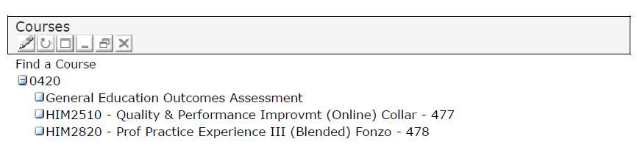
Pilot Administration
Angel Course list

Slide 22
Pilot Administration

Slide 23
Frequently Asked Questions
Frequently Asked Questions (FAQs)
General Education Outcomes Assessment
1. Why has this course been added to my ANGEL page?
This course is listed on your ANGEL page because you have been selected to participate in the General Educational
Assessment due to your successful completion of 45 or more credit hours of combined SPC and transfer credits.
2. What is the purpose of this assessment?
The purpose of the General Education Assessment is to evaluate the quality of our general education curriculum. The
aggregate results of this assessment will assist in improving our general education courses, as part of the College’s
commitment to continuous improvement.
The assessment also satisfies our obligation to the Southern Association of Colleges and Schools (SACS), our
accrediting entity which ensures the high quality of the degree you will receive upon graduation.
3. Why do I have to take the assessment if a portion of my total credits are transfer credits?
Students who have completed a total of 45 credits including SPC and transfer credits were selected. Your results and
those of other SPC students will assist us in improving the general education courses and ensuring that we meet the
needs of our students.

Slide 24
Frequently Asked Questions
4. Why do I have to take the assessment if I am pursuing a degree in a specific discipline?
As per our agreement with our accreditation body, the Southern Association of Colleges and Schools, students across
all disciplines are required to take a specified number of general education courses as part of their degree requirement.
As a result, all students, regardless of discipline, who have completed 45 credits were selected to participate in the
General Educational Assessment. Your results and those of other SPC students will assist us in improving the general
education courses and ensuring that we meet the needs of our students.
5. What is the deadline for completing this assessment?
The assessment will be available on your ANGEL course until one week before the end of the current term.
6. How long does it take to complete the assessment?
On average the assessment takes about 40 minutes to complete. You will be given a ninety-minute time limit.
7. May I use a calculator?
You may use a calculator, and we suggest that you have scratch paper available when taking the assessment.
8. I opened the assessment but closed it without completing it. May I complete the assessment at a later time?
Yes, you may access and complete the assessment at a later time as long as you do not select ‘Begin Assessment’.
Once you select the option to begin the assessment you must complete and submit it within ninety minutes.

Slide 25
Frequently Asked Questions
9. How do I know if I passed the assessment?
The score you receive on the assessment is a percentage of your correct responses, however there is no pass or fail associated with
the score. The results of the assessment are only used to assist us in improving the general education courses.
10. Why am I unable to listen to the audio file needed to answer the related item(s) in the assessment?
This issue may be the result of an older version of the Flash Player installed on your computer. Older Flash Player versions may
have a compatibility issue with the current version of ANGEL that we are using at the College. If you are taking the assessment and
have the issue, you may ignore that item(s) on the assessment.
11. How should I respond to the ‘Security Warning’ message: ‘Do you want to view only the webpage content that was
delivered securely?'
The correct response to the Security Warning message is to select 'NO'.
12. Will the results of this assessment affect my grades?
The results of this assessment will remain confidential, and will not affect your course grades or overall grade point average. Your
results will be combined with those of other SPC students to assist us in improving the general education curriculum.
13. Who should I contact with additional questions?
If you have any additional questions regarding this assessment, please contact the department of Academic Effectiveness and
Assessment at 727.712.5237, or ortiz.mary@spcollege.edu.

Slide 26
Pilot Administration
Multiple Student Contacts
  Several student reminders are sent periodically to non-respondents, using email merge
  One student reminder is sent via paper mail
  Scripts are used to respond promptly to student inquiries

Slide 27
Is this assessment required?
The purpose of the General Education Assessment is to evaluate the quality of our general
education curriculum. The results of this assessment will assist in improving our general
education courses, as part of the Colleges’ commitment to continuous improvement.
In addition to using the aggregate assessment results for quality improvement proposes, the
assessment also satisfies our obligation to the Southern Association of Colleges and
Schools (SACS). This is extremely important for the institution and for our students. For
without accreditation, the diploma that you will receive when you graduate would not be as
meaningful for future pursuits.
The results of this assessment will remain confidential, and will not affect your course grades
or overall grade point average. Your results will be combined with those of other SPC
students to assist us in improving the general education curriculum.
Although completion of this assessment is not a graduation requirement, it is of great
importance to SPC and to our students.

Slide 28
Pilot Administration
Administrations
Online assessment was piloted in Spring and Summer 2010 using a single form
Fall 2010 pilot included three different forms of the assessment
Spring 2011 is being administered with the same three forms
  Scores are transferred from ANGEL to PeopleSoft

Slide 29
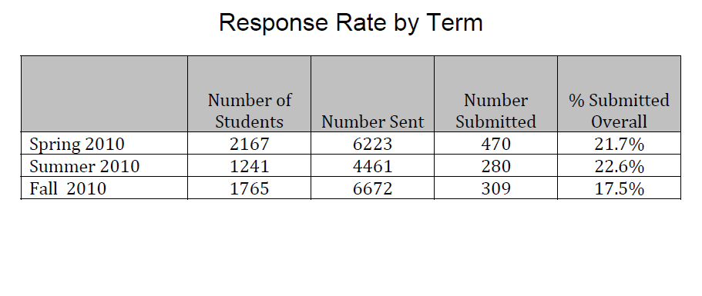
Results

Slide 30
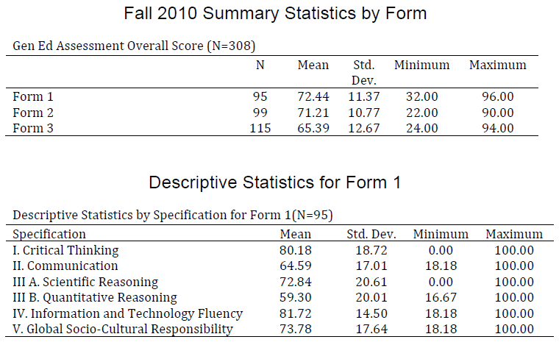
Results

Slide 31
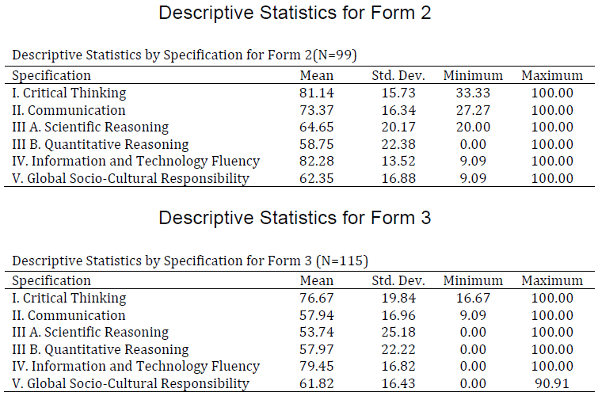
Results

Slide 32
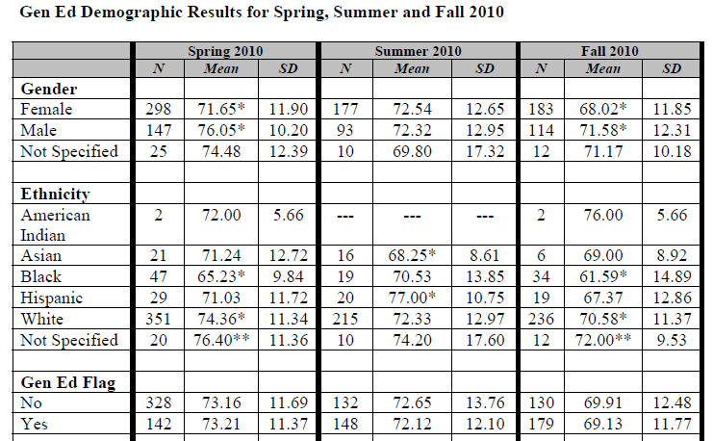
Results

Slide 33
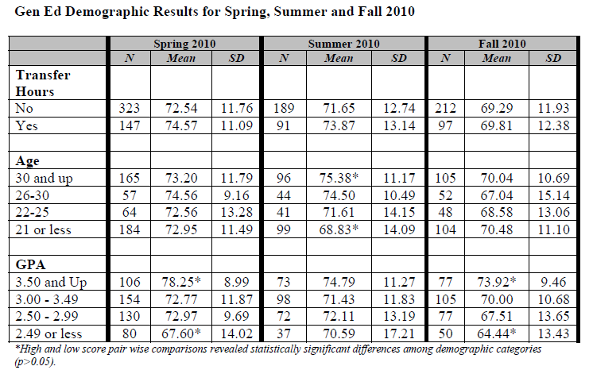
Results

Slide 34
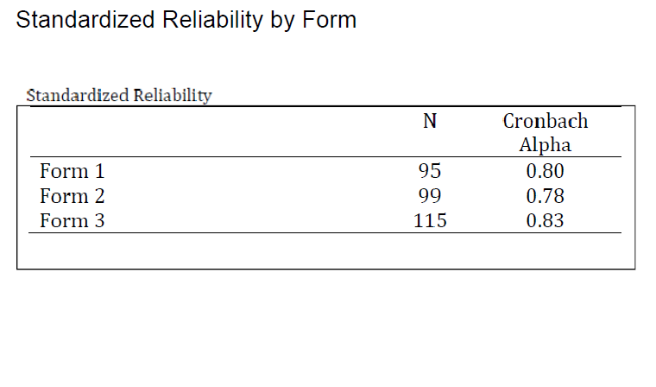
Results

Slide 35
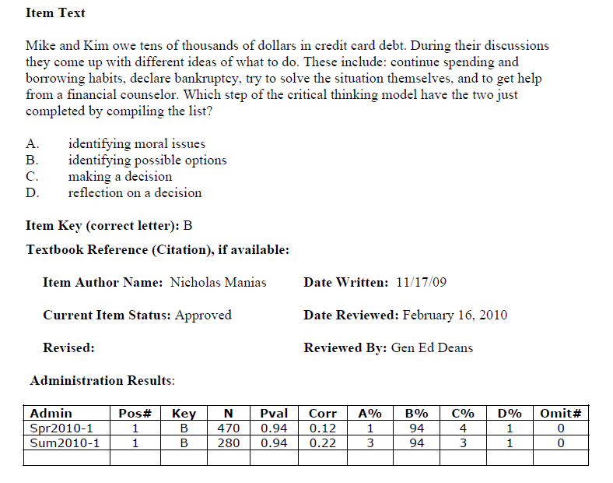
Results

Slide 36
General Education Assessment
Advantages of Assessment
Institutional-based as opposed to classroom-based
Potential for higher participant rate
Better representation from Gen Ed Completers
Results are generalizble to SPC population
More representative results from students who have completed the majority of Gen Ed and other courses
Removes impact on classroom time

Slide 37
Lessons Learned
Faculty involvement is crucial
Requires academic structure such as Gen Ed Deans to be successful
Need psychometric resources
A technology infrastructure is necessary
Senior leadership endorsement and support is vital
Requires adequate staff and resources

Slide 38
Next Steps
Continue to administer pilot forms 1, 2, and 3 of the Institutional Assessment in the Spring and Summer Terms of 2011
Analyze the results of pilot forms 1, 2, and 3
Using the analysis results, develop three equal forms in terms of item difficulty
Develop and pilot forms 4 and 5 of the Institutional Assessment
Continue to analyze all forms to determine validity and reliability

Slide 39
Next Steps
Convene a subcommittee to
  develop a proposed timeline for SPC to implement a plan in which the Institutional Assessment would be mandatory for all students before graduation
  research the requisites and procedures required to place the Gen Ed score on student transcripts
Begin widely disseminating assessment results on such websites as the
  Academic Effectiveness site
  Center of Excellence for Teaching and Learning site

Slide 40
Questions

Slide 41
Florida Association of Institutional Research
2011 Annual Conference
General Education
Institutional Assessment
February 2011

